Slide 1

Literature Classification and Its Text Summarization
Presented By:
Laxmi Yadav
Bryan Dilone
Harsha Vardhan Kuruva

Slide 2
Introduction
Overall, this project can help us gain insights into the patterns and trends in COVID-19 research
It provide a valuable resource for healthcare professionals and researchers who need to stay up-to-date on the latest developments in the field.

Slide 3
Why this project?
Relevance
By working on this project, researchers and developers can contribute to advancing the state of the art in NLP and potentially create tools that can be useful in various fields such as journalism, academia, and publishing.
Complexity
These tasks involve processing large amounts of unstructured text data and extracting meaningful information from it.
Impact
The ability to accurately classify and summarize literature can have a significant impact on various fields

Slide 4
Hypothesis
Is it possible to obtain a summary of the article while ensuring that no important information is left out?
Can grouping research articles that are similar through clustering make it easier to find related publications?

Slide 5
About the Data
●https://www.kaggle.com/datasets/allen-institute-for-ai/CORD-19-research-challenge
COVID-19 Open Research Dataset Challenge (CORD-19)
(nearly 1,000,000 scholarly works about COVID-19, SARS-CoV-2, and associated coronaviruses, including over 400,000 in full text)
Size= 20GB
The files in each version are:
Change log
Cord_19_embeddings.tar.gz
Document_parses.tar.gz:
Metadata.csv

Slide 6
Data Ingestion
Metadata.csv file contains values corresponding to full text JSON files
This JSON files contain, full text of article, title, author, abstract, etc.
I created a subset file with this articles in ArticlesText1000.csv
Articles will be the unit of analysis here.

Slide 7

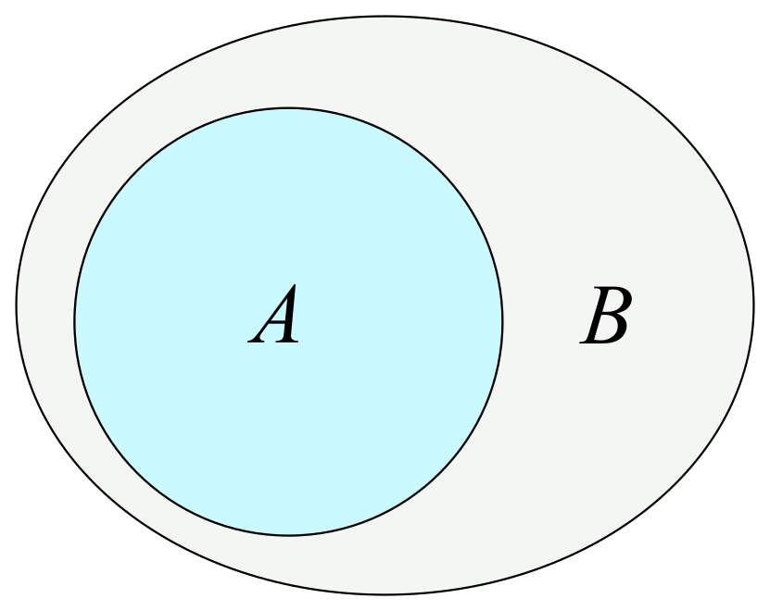

Data Features
Original dataset consists of nearly 1,000,000 work articles and its size is 20 GB
The subset dataset consists of 1000 articles and its size is around 30 MB

Slide 8
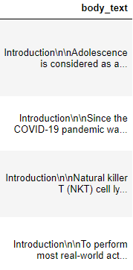

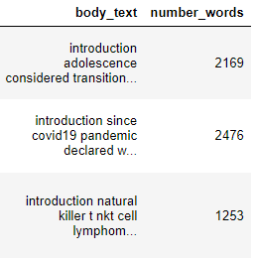
Initial Data Cleaning and Preprocessing
Initiated the data cleaning process by removing stop words (“a,the,is,are”), punctuation, and making the text lowercase.
Before
After
Results
Next step was to identify the number of words presented within each document.

Slide 9
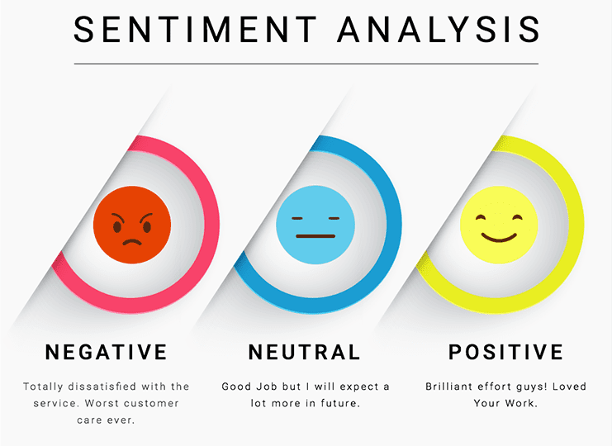
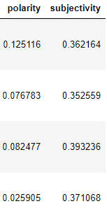
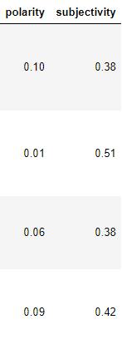
Initial Data Cleaning and Preprocessing cont.
Onto the Data Preprocessing step, we’ve implemented the technique Sentiment Analysis (opinion mining). This technique is used in two different ways, to determine whether the data is positive, negative, or neutral (Polarity), and determine whether a sentence expressed an opinion or not (Subjectivity).
Before
After
The next couple of slides would display the graphed outcomes of the Data Preprocessing step.

Slide 10
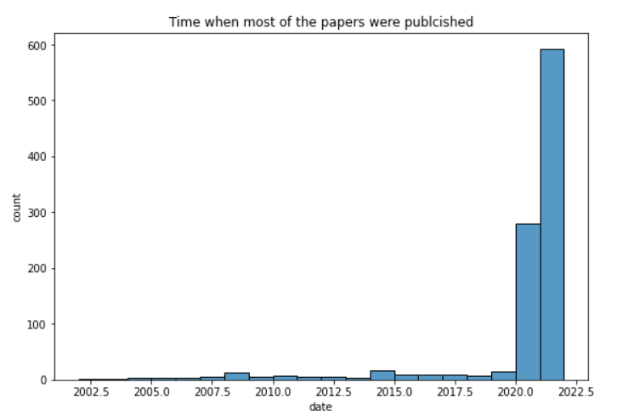
Initial EDA
The plot shows in which year the most of the articles were published

Slide 11
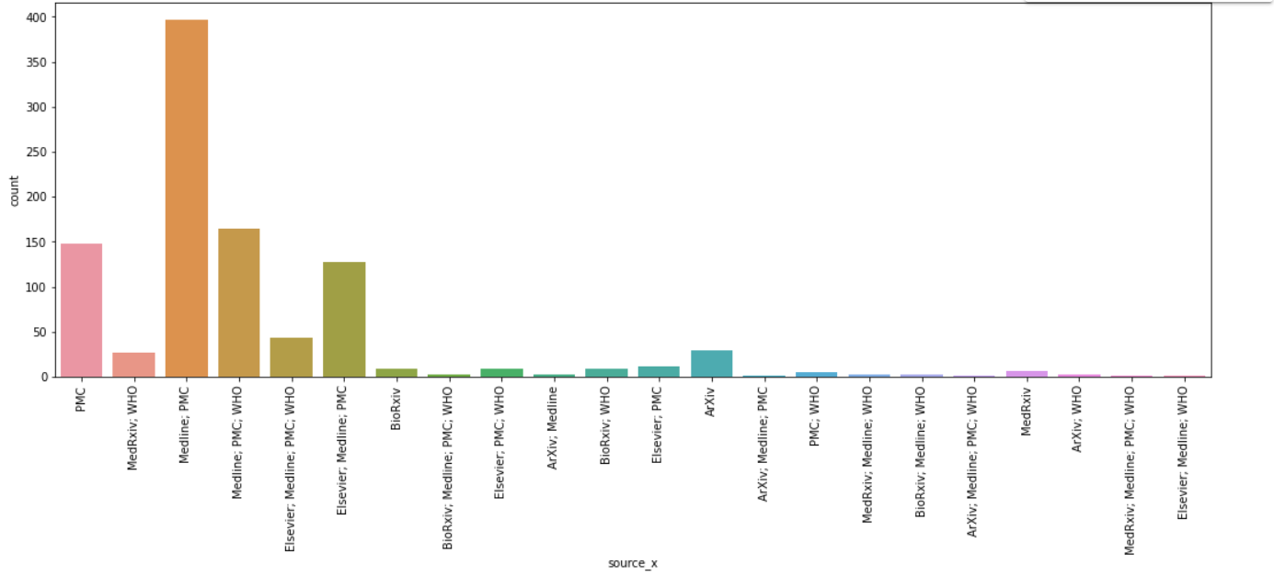
This Graph shows from which organization most of the articles were published
Notes:
As per the graph it is safe to conclude that the data sources are credible and we are working on the right data set

Slide 12
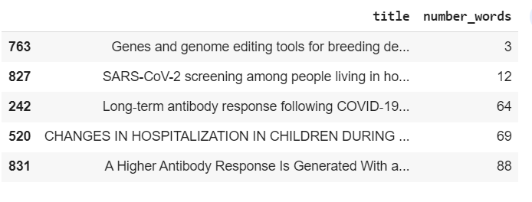
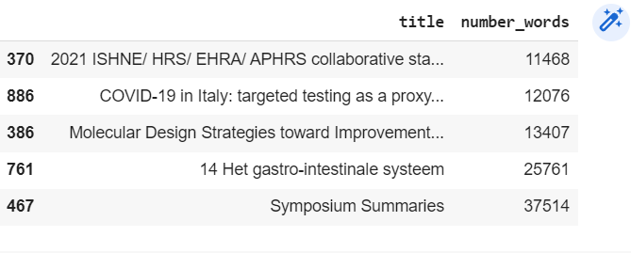
The below one shows the articles which contains the highest and lowest number of words

Slide 13
References
https://www.jmlr.org/papers/volume21/19-763/19-763.pdf
https://allenai.org/data/cord-19
https://www.semanticscholar.org/paper/CORD-19%3A-The-Covid-19-Open-Research-Dataset-Wang-Lo/4a10dffca6dcce9c570cb75aa4d76522c34a2fd4
https://towardsdatascience.com/text-classification-in-python-dd95d264c802
https://www.altexsoft.com/blog/business/sentiment-analysis-types-tools-and-use-cases/

